Slide 1



International T20 Matches
An analytical approach by Ankit Shrivas

Slide 2


Introduction
This MySQL-based project analyzes T20 international cricket matches played in 2024, focusing on team performance metrics and match outcomes. The database encompasses detailed match information including teams, winners, margins of victory, venues, and dates. Through SQL queries, we explore various aspects like winning streaks, victory margins, and head-to-head statistics to gain insights into team performances across different venues and conditions.

Slide 3
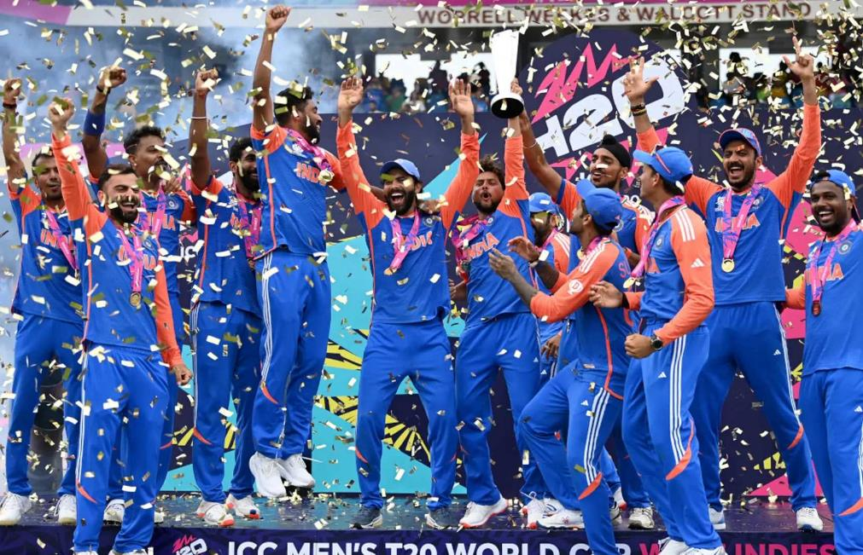

Project Objective
The objective of this project is to analyze T20 International cricket matches by examining match outcomes, winning margins, and team performances over time. The dataset includes details such as competing teams, match results, venue locations, and match dates. Through this analysis, we aim to identify trends in team performances, dominant teams, frequently used venues, and winning patterns in T20 cricket.

Slide 4
About Dataset
This dataset has been taken from a YouTube channel, where the creator provided an SQL script for analysis. The dataset contains records of T20 International cricket matches, including details such as match outcomes, winning margins, competing teams, venues, and match dates. The data is structured to facilitate SQL-based analysis and helps in identifying trends in team performances, frequently used venues, and match-winning patterns in T20 cricket.

Slide 5
Database and Table Creation
CREATE DATABASE t20imatches;
USE t20imatches;
CREATE TABLE t20 (
Team1 VARCHAR(50),
Team2 VARCHAR(50),
Winner VARCHAR(50),
Margin VARCHAR(50),
MatchDate DATE,
Ground VARCHAR(50)
);

Slide 6
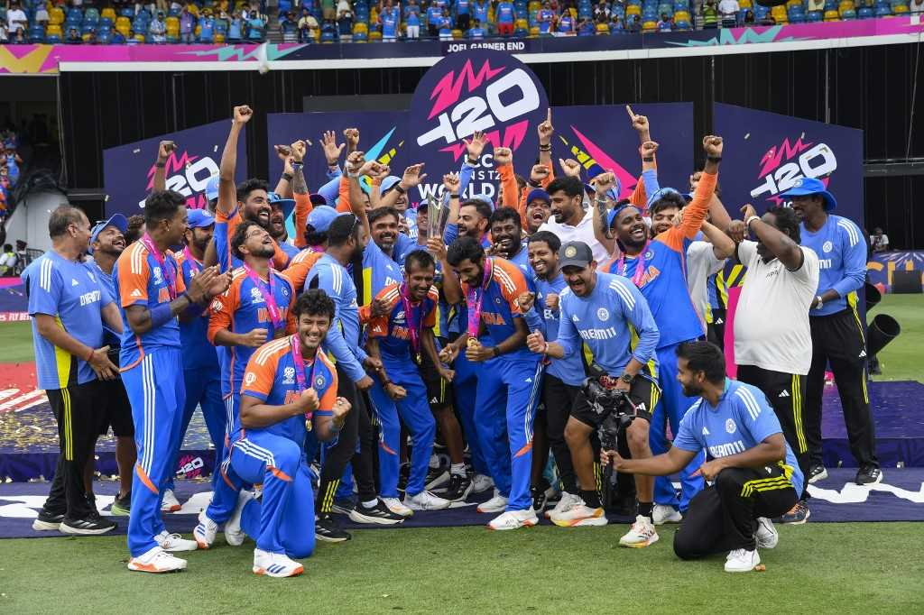
QUESTIONS
Q1. Find the team with the highest number of wins in 2024 and the total matches it won.
SELECT Winner, COUNT(*) AS 'Number of Wins'
FROM T20
WHERE YEAR(MatchDate) = 2024
GROUP BY Winner
ORDER BY COUNT(*) DESC
LIMIT 1;

Slide 7
Q2. Rank the teams based on the total number of wins in 2024.alter
SELECT Winner, COUNT(*) AS 'Number of Wins',
RANK() OVER(ORDER BY COUNT(*) DESC) AS RANK_Assigned
FROM T20
WHERE Winner NOT IN ('tied', 'no result')
GROUP BY Winner;

Slide 8

Q3.Which team had the highest average winning margin (in runs), and what was the average margin ?
SELECT Winner,
AVG(CAST(SUBSTRING_INDEX(Margin, ' ', 1) AS UNSIGNED)) AS Avg_Margin
FROM T20
WHERE Margin LIKE '%runs%'
GROUP BY Winner
ORDER BY Avg_Margin DESC
LIMIT 1;

Slide 9
Q4. Find the average winning margin for each team in matches won by wickets in 2024.
SELECT Winner AS Team,
AVG(CAST(SUBSTRING_INDEX(Margin, ' ', 1) AS UNSIGNED)) AS Avg_Margin_wickets
FROM T20
WHERE Margin LIKE '%wickets%' AND YEAR(MatchDate) = 2024
GROUP BY Winner
ORDER BY Avg_Margin_wickets DESC;

Slide 10
Q5. Identify matches played between two specific teams (e.g., India and South Africa) in 2024 and their results.
SELECT *
FROM T20
WHERE ((Team1 = 'India' AND Team2 = 'South Africa')
OR (Team1 = 'South Africa' AND Team2 = 'India'))
AND YEAR(MatchDate) = 2024;

Slide 11
Q6. List all matches where the winning margin was greater than the average margin across all matches.
SELECT T.Team1, T.Team2, T.Winner, T.Margin
FROM T20 T
JOIN (
SELECT AVG(CAST(SUBSTRING_INDEX(Margin, ' ', 1) AS UNSIGNED)) AS Avg_Overall_Margin
FROM T20
WHERE Margin LIKE '%runs%'
) A ON 1=1
WHERE T.Margin LIKE '%runs%'
AND CAST(SUBSTRING_INDEX(T.Margin, ' ', 1) AS UNSIGNED) > A.Avg_Overall_Margin;

